Slide 1

Huffman Coding
BRACT’s Vishwakarma Institute of Information Technology , Pune 48 Department Of Computer Engineering
Academic Year : 2021-2022 Semester : IV
Guided by : Prof. Devika Verma Mam
GROUP NO : 04

Slide 2
Team
Roll No | Name | Email Id
222029 | Kartik Koul | kartik.22010321@viit.ac.in
222030 | Raj Kasat | raj.22010722@viit.ac.in
222031 | Mitali Kate | mitali.22010295@viit.ac.in
222032 | Ketan Gupta | ketan.22010428@viit.ac.in
222033 | Ketan Mesharam | ketan.22011040@viit.ac.in
222080 | Prajwal Zade | Prajwal.22120195@viit.ac.in

Slide 3
Huffman Coding
Huffman encoding is a type of variable-length encoding that is based on the actual character frequencies in a given document.
Huffman encoding uses a binary tree:
• To determine the encoding of each character
• To decode an encoded file – i.e., to decompress a compressed file, putting it back into ASCII values.

Slide 4
Advantages and Disadvantages of Huffman
The Huffman encoding scheme takes advantage of the disparity between frequencies and uses less storage for the frequently occurring characters at the expense of having to use more storage for each of the more rare characters.
One disadvantage of the Huffman code is that it can only assign integer-length codewords. This usually leads to a suboptimal performance. For example, a symbol ‘a’ was represented with a 3-bit codeword, whereas its information content is only 2.32 bits.

Slide 5
Advantages of Huffman Coding
This encoding scheme results in saving lot of storage space, since the binary codes generated are variable in length.
It generates shorter binary codes for encoding symbols/characters that appear more frequently in the input string.
The binary codes generated are prefix-free

Slide 6
Disadvantages of Huffman Coding
Lossless data encoding schemes, like Huffman encoding, achieve a lower compression ratio compared to lossy encoding techniques. Thus, lossless techniques like Huffman encoding are suitable only for encoding text and program files and are unsuitable for encoding digital images.
Huffman encoding is a relatively slower process since it uses two passes- one for building the statistical model and another for encoding. Thus, the lossless techniques that use Huffman encoding are considerably slower than others...
Since length of all the binary codes is different, it becomes difficult for the decoding software to detect whether the encoded data is corrupt. This can result in an incorrect decoding and subsequently, a wrong output.

Slide 7
Real-life applications of Huffman Coding-
Huffman encoding is widely used in compression formats like GZIP, PKZIP (WinZip) and BZIP2.
Multimedia codecs like JPEG, PNG and MP3 uses Huffman encoding (to be more precise the prefix codes.
Huffman encoding still dominates the compression industry since newer arithmetic and range coding schemes are avoided due to their patent issues.

Slide 8
Steps in Huffman Coding
There are two major steps in Huffman Coding-
Building a Huffman Tree from the input characters.
Assigning code to the characters by traversing the Huffman Tree.

Slide 9
Steps To Build Up Huffman Tree
Step-01:
Create a leaf node for each character of the text.
Leaf node of a character contains the occurring frequency of that
character.
Step-02:
Arrange all the nodes in increasing order of their frequency value (in
the form of priority queue or min-heap).

Slide 10
Step-03:
Considering the first two nodes having minimum frequency.
Create a new internal node.
The frequency of this new node is the sum of frequency of those
two nodes.
Make the first node as a left child and the other node as a right
child of the newly created node.
Step-04:
Keep repeating Step-02 and Step-03 until all the nodes form a
single tree.
The tree finally obtained is the desired Huffman Tree.

Slide 11
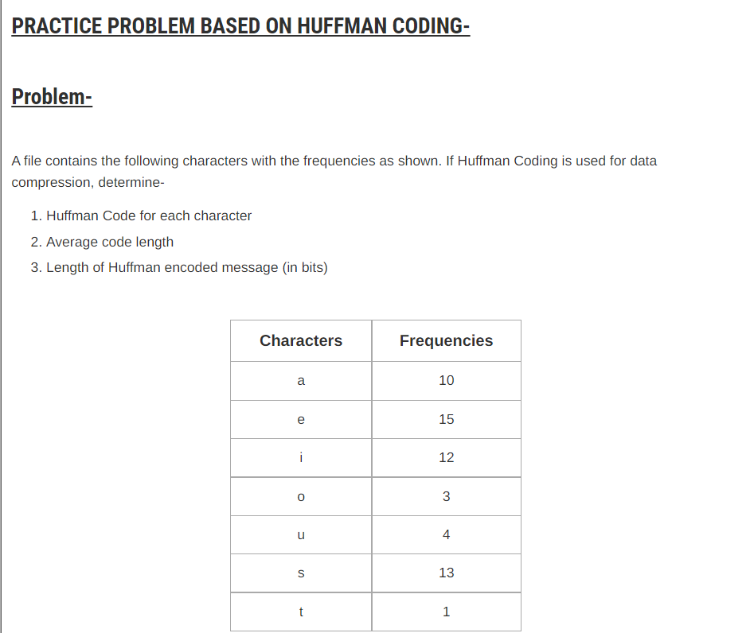

Slide 12
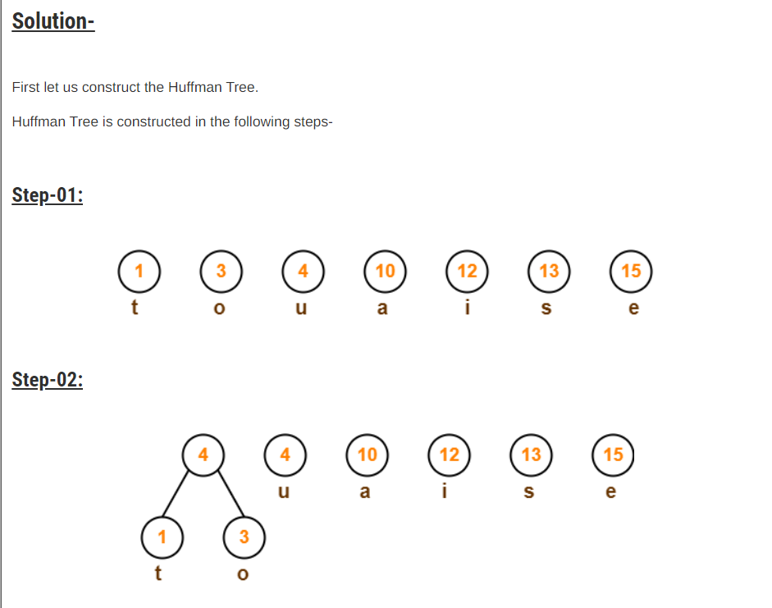

Slide 13
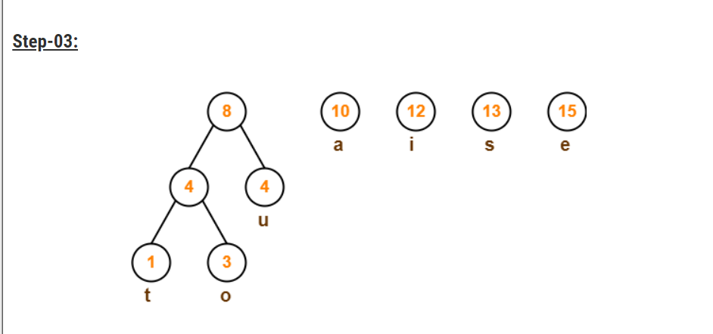

Slide 14
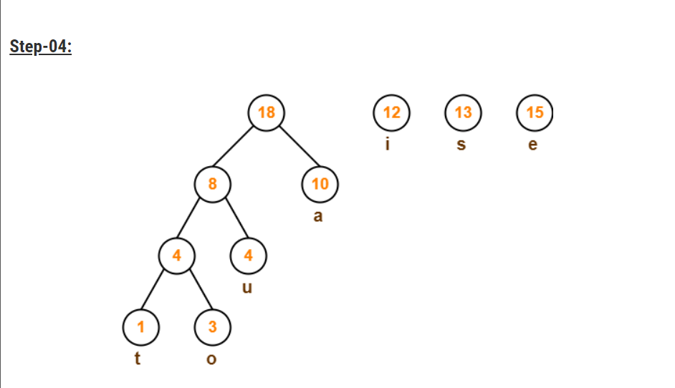

Slide 15
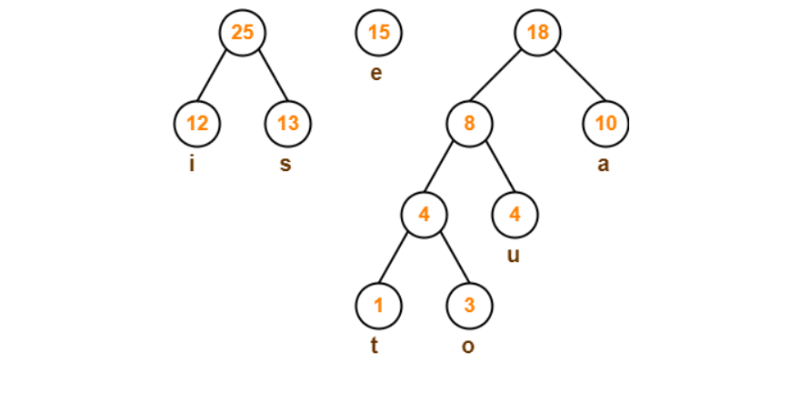

Slide 16
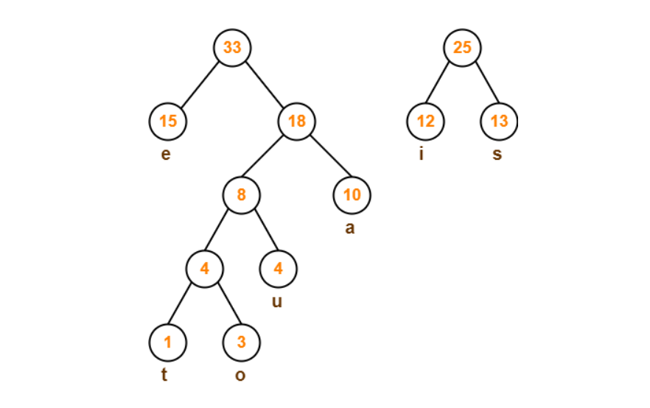

Slide 17
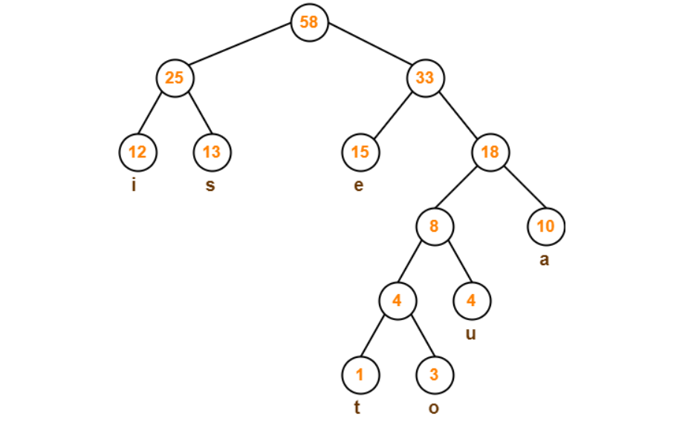

Slide 18
Now,
We assign weight to all the edges of the constructed Huffman Tree.
Let us assign weight '0' to the left edges and weight '1' to the right edges.
Rules:
If you assign weight '0' to the left edges, then assign weight '1' to the right edges.
If you assign weight '1' to the left edges, then assign weight 'O' to the right edges.
Any of the above two conventions may be followed.
But follow the same convention at the time of decoding that is adopted at the time of encoding.

Slide 19
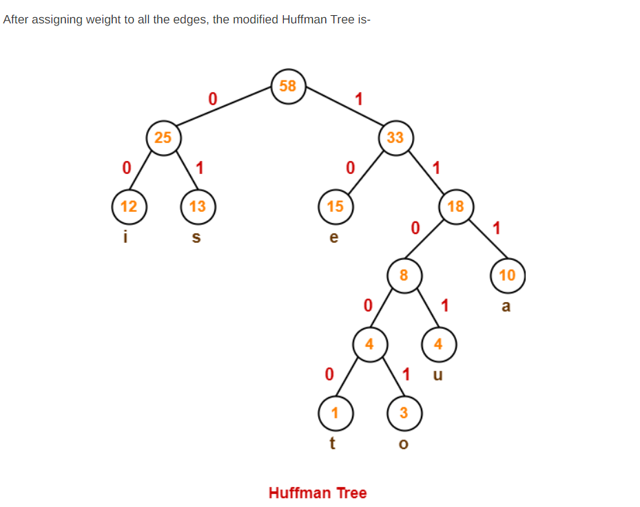

Slide 20
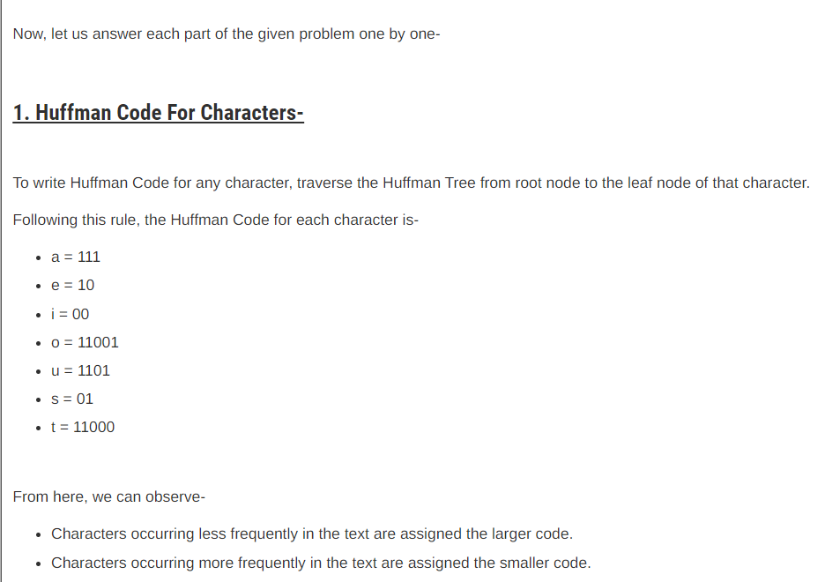

Slide 21
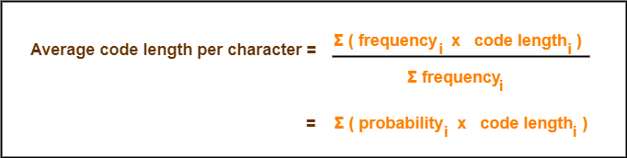
Important formulas :
Formula No.1 :
Formula No.2 :
Total number of bits in Huffman encoded message
= Total number of characters in the message x Average code length
= ∑ ( frequency_{i} x Code length_{i} )

Slide 22
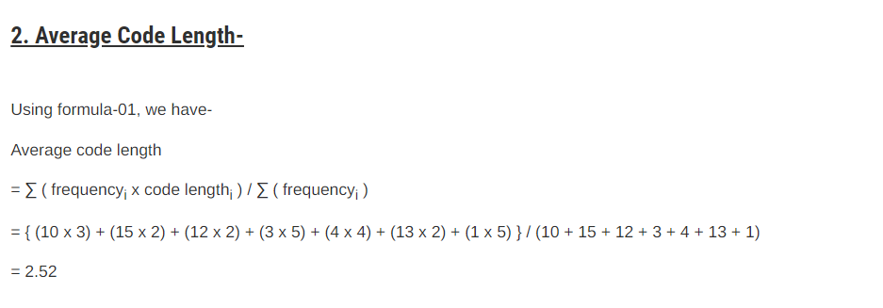

Slide 23
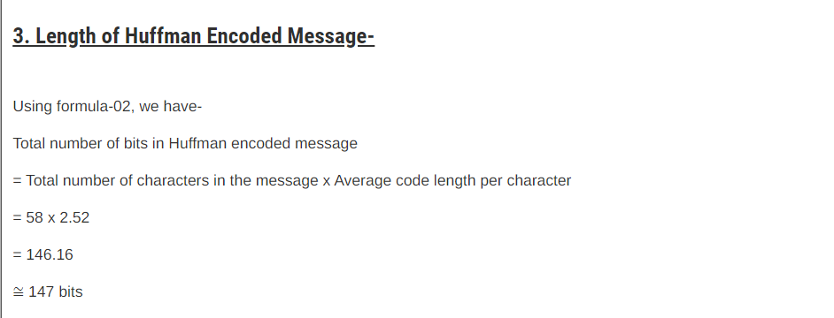

Slide 24
Code Explanation

Slide 25
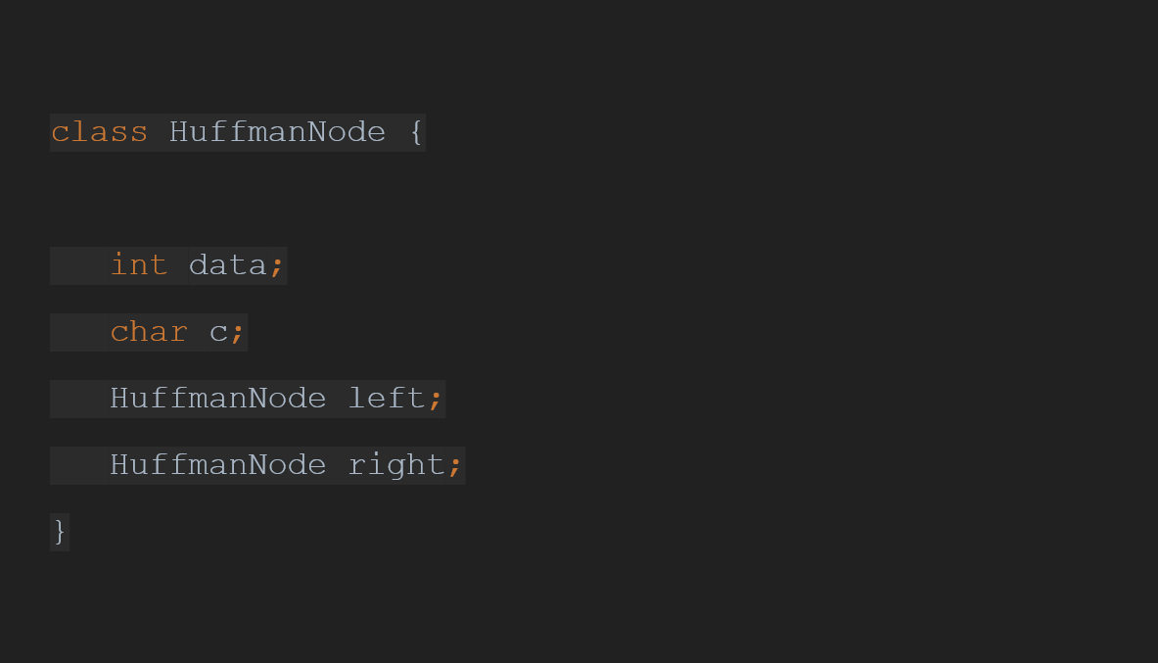

Slide 26


Slide 27
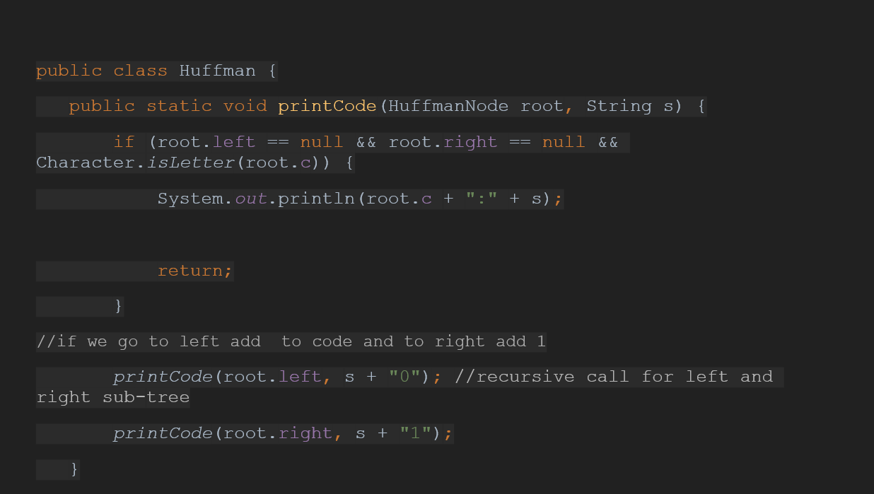

Slide 28
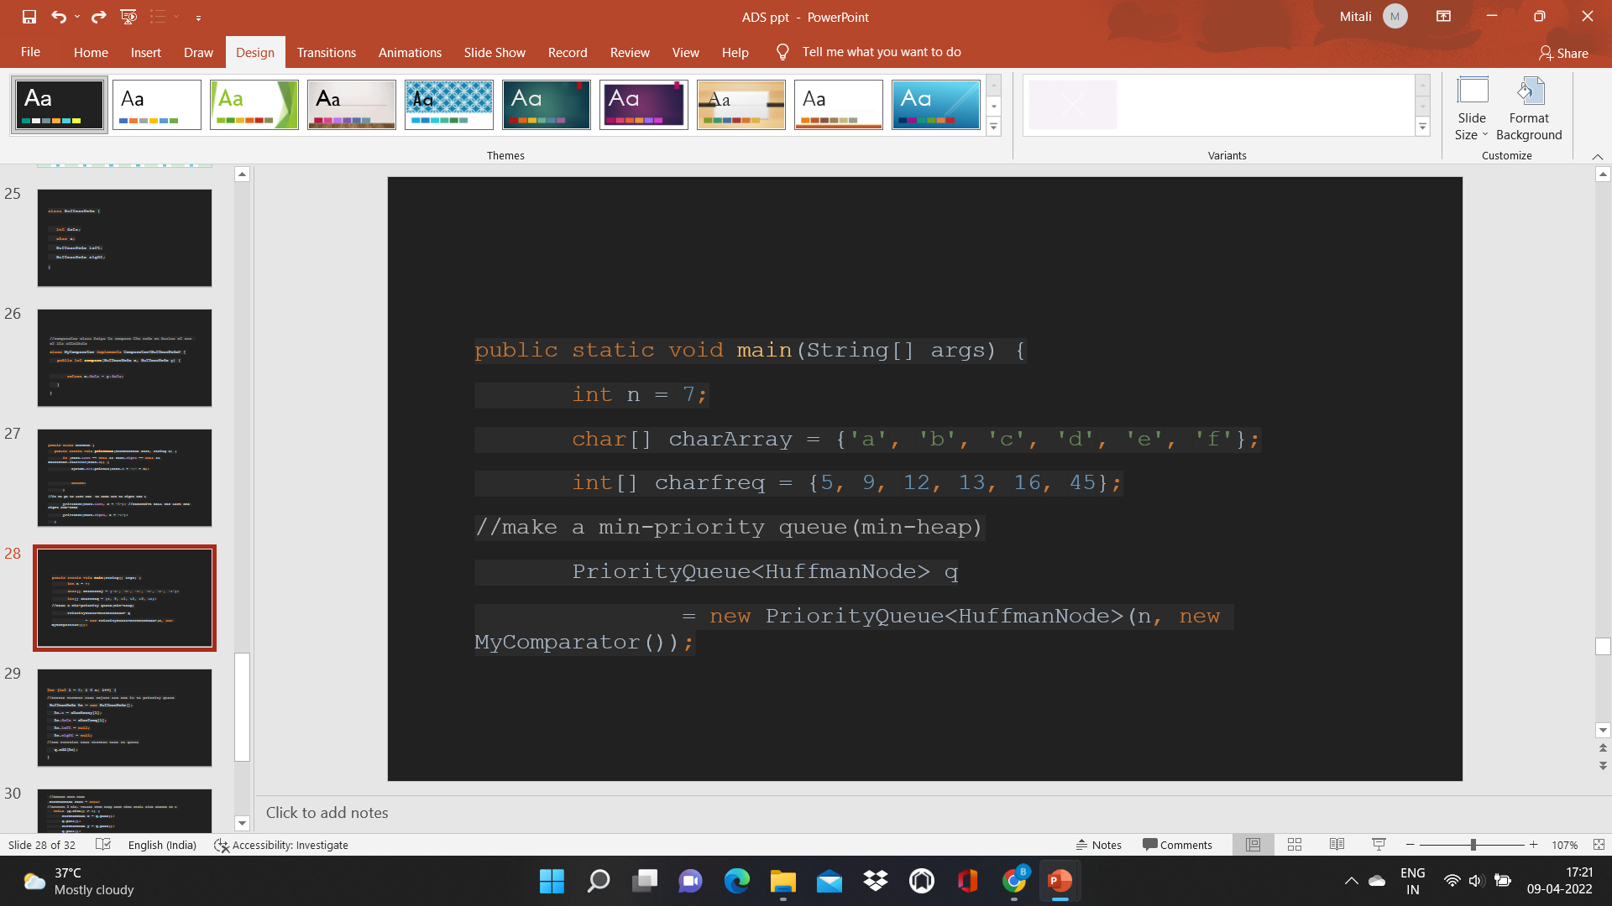

Slide 29
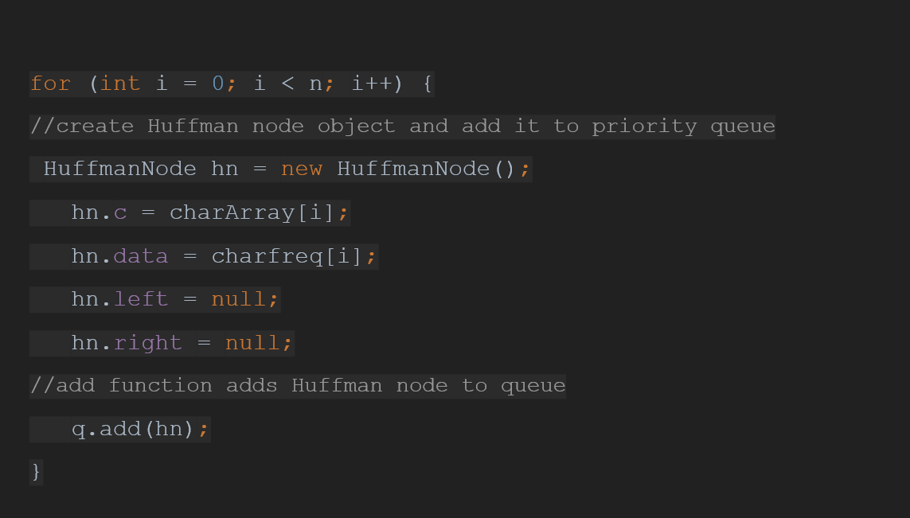

Slide 30
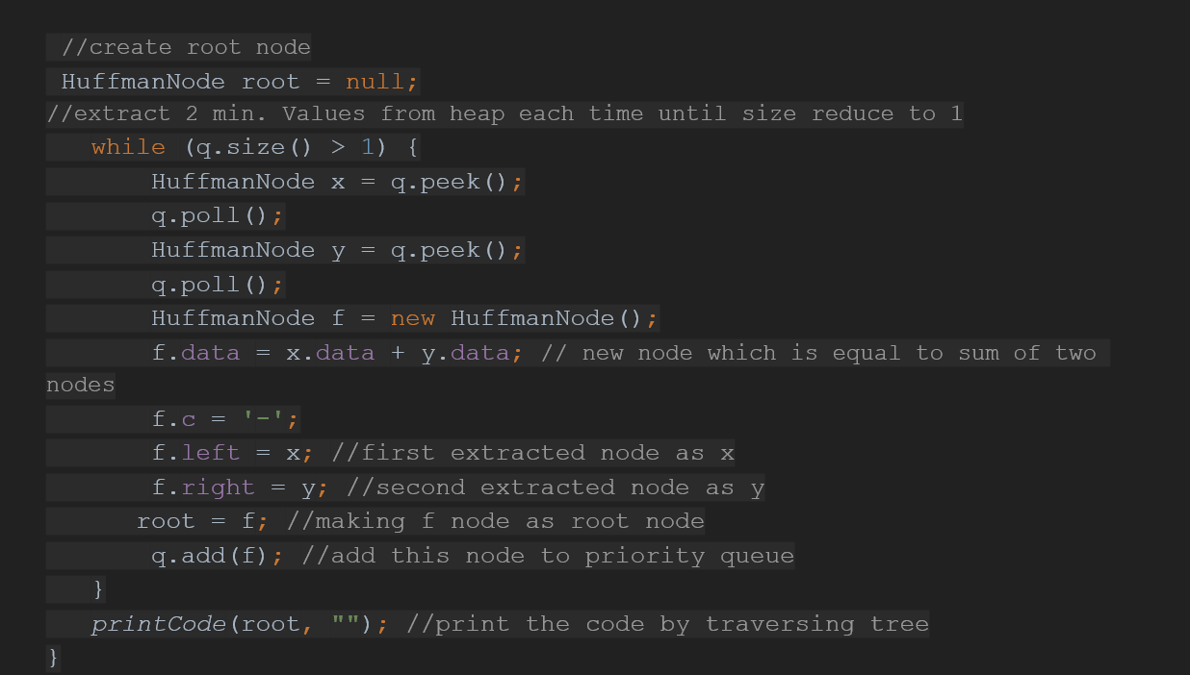

Slide 31
Reference
https://www.geeksforgeeks.org/huffman-coding-greedy-algo-3/
https://www.javatpoint.com/huffman-coding
https://www.programiz.com/dsa/huffman-coding
https://www.youtube.com/watch?v=uDS8AkTAcIUhttps://www.youtube.com/watch?v=uDS8AkTAcIU

Slide 32
THANK YOU

